Slide 1
HOSPITAL MANAGEMENT SYSTEM
‘where architecture clashes with vibe coding’

Slide 2

Table of contents
400
Bad Request

Slide 3
How much chaos can you fit into a single desktop application?

Slide 4
We found the limit, and then crossed it.

Slide 5
On a serious note…

Slide 6
On a serious note…
…let’s talk architecture.

Slide 7
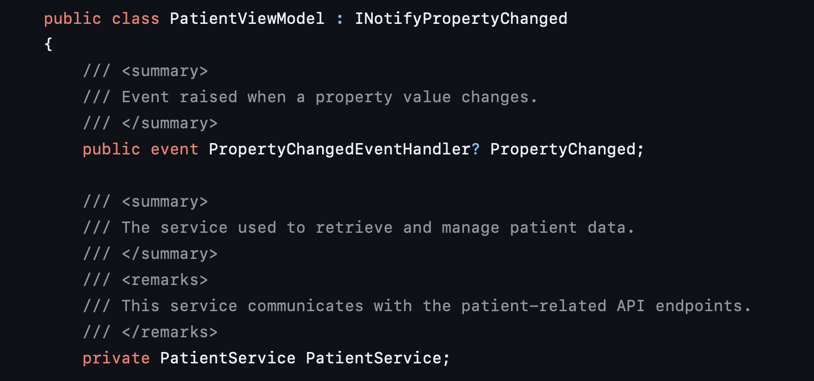
From tightly coupled architecture…

Slide 8
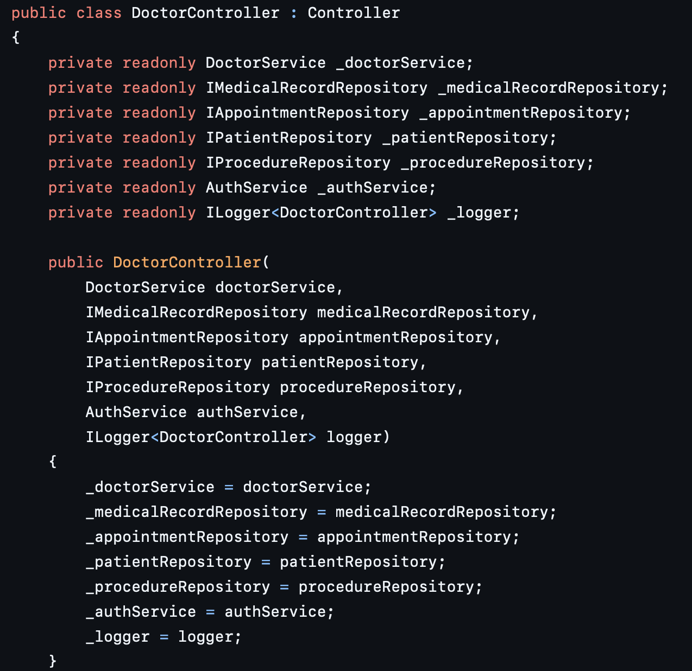
…to whatever the f*ck this is

Slide 9
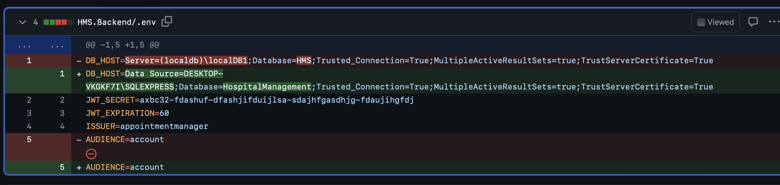
A picture is worth a thousand words

Slide 10
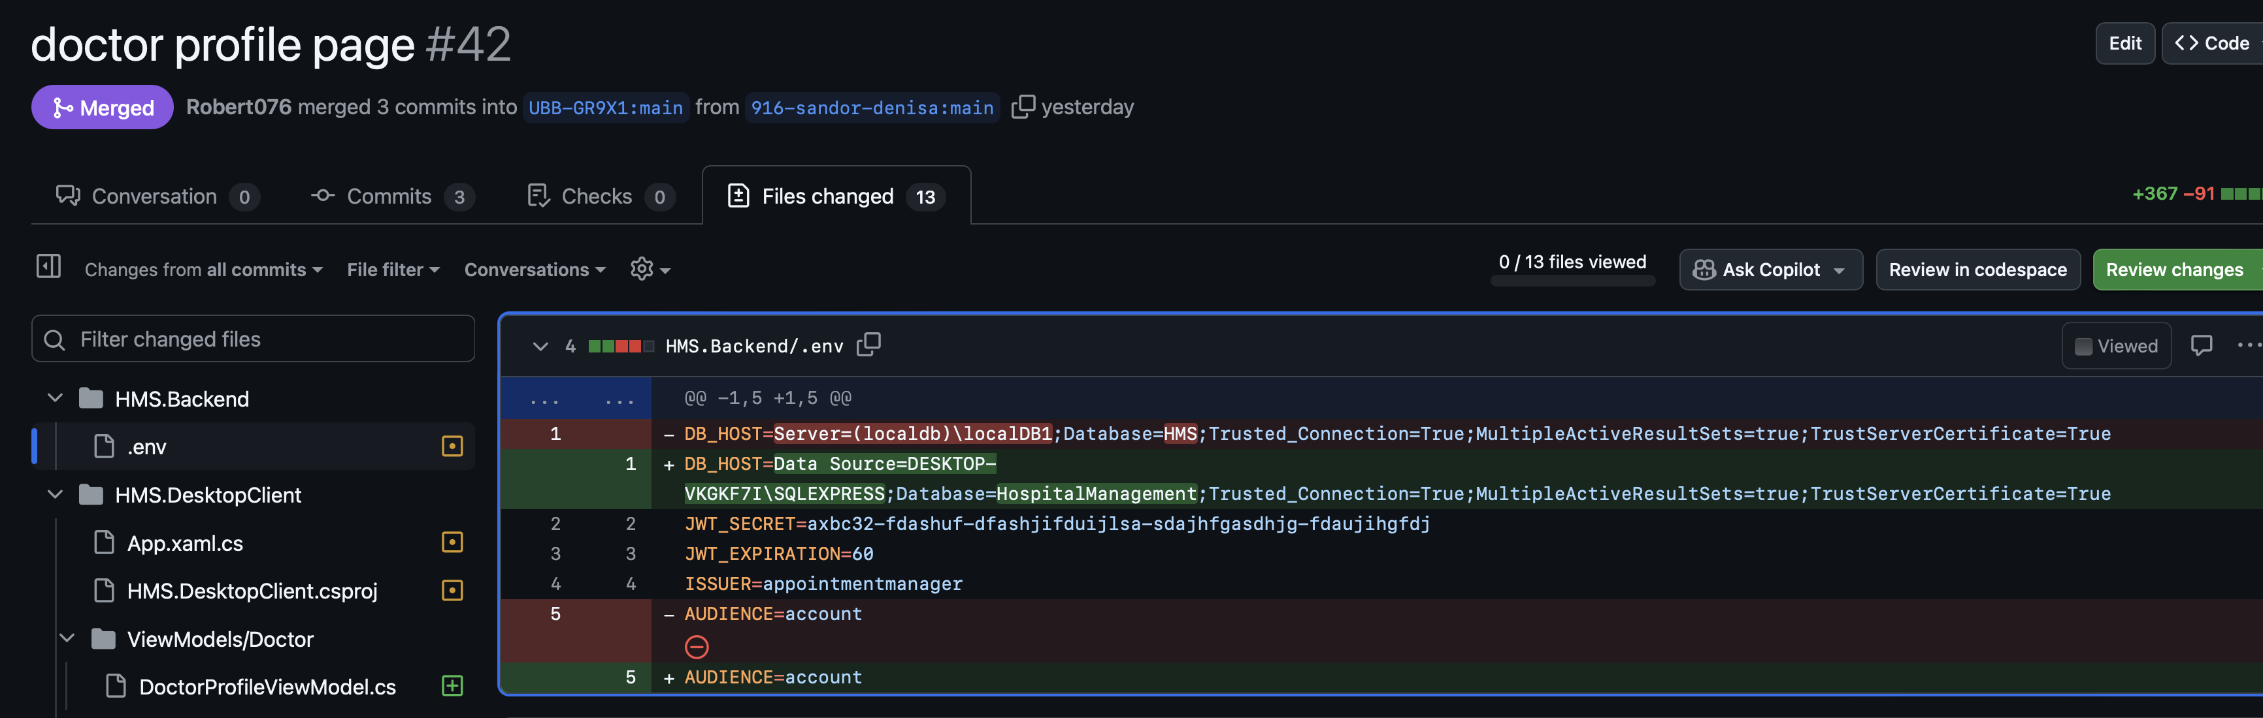
And guess what?

Slide 11

We’ve had our frustrations…

Slide 12
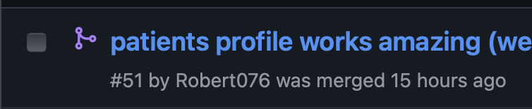
…but in the end, it was worth it

Slide 13
We’ve made friends along the way…

Slide 14
…and so did these two

Slide 15
Meet our team

Slide 16








Meet our team
1 – The vibe coders:

Slide 17









Meet our team
2 – The other vibe coders:

Slide 18
Are you still watching?

Slide 19

Are you still watching?

Slide 20
Our fundamental belief

Slide 21
Our fundamental belief
Users only care about UX.

Slide 22
But here’s what we found out the hard way

Slide 23
The code maintainers look further than just the UX.

Slide 24
So yea, we’ve learned our lesson:

Slide 25

"Always code as if the guy who ends up maintaining your code will be a violent psychopath who knows where you live.” - John Woods

Slide 26
Now that our story is out of the way, let’s move onto the boring stuff

Slide 27
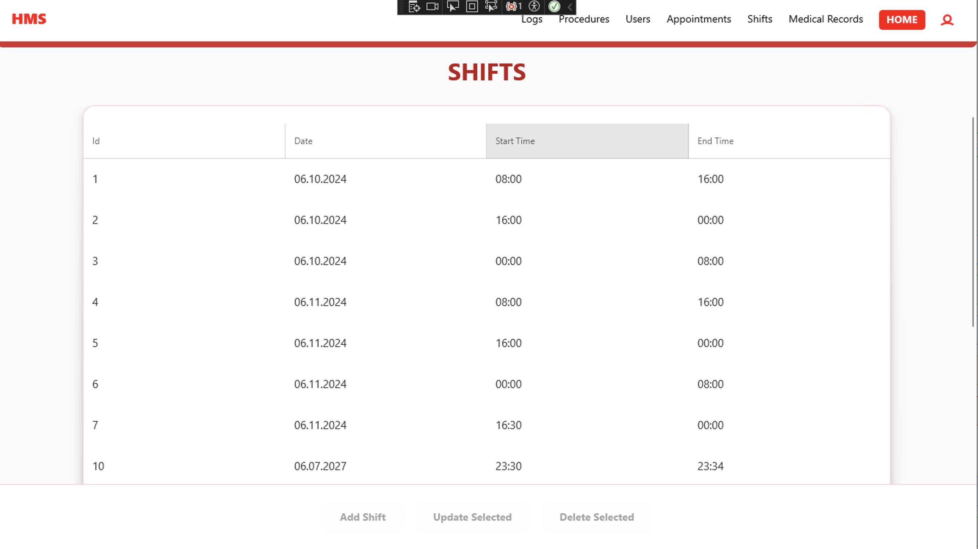
The admin dashboard - Desktop

Slide 28
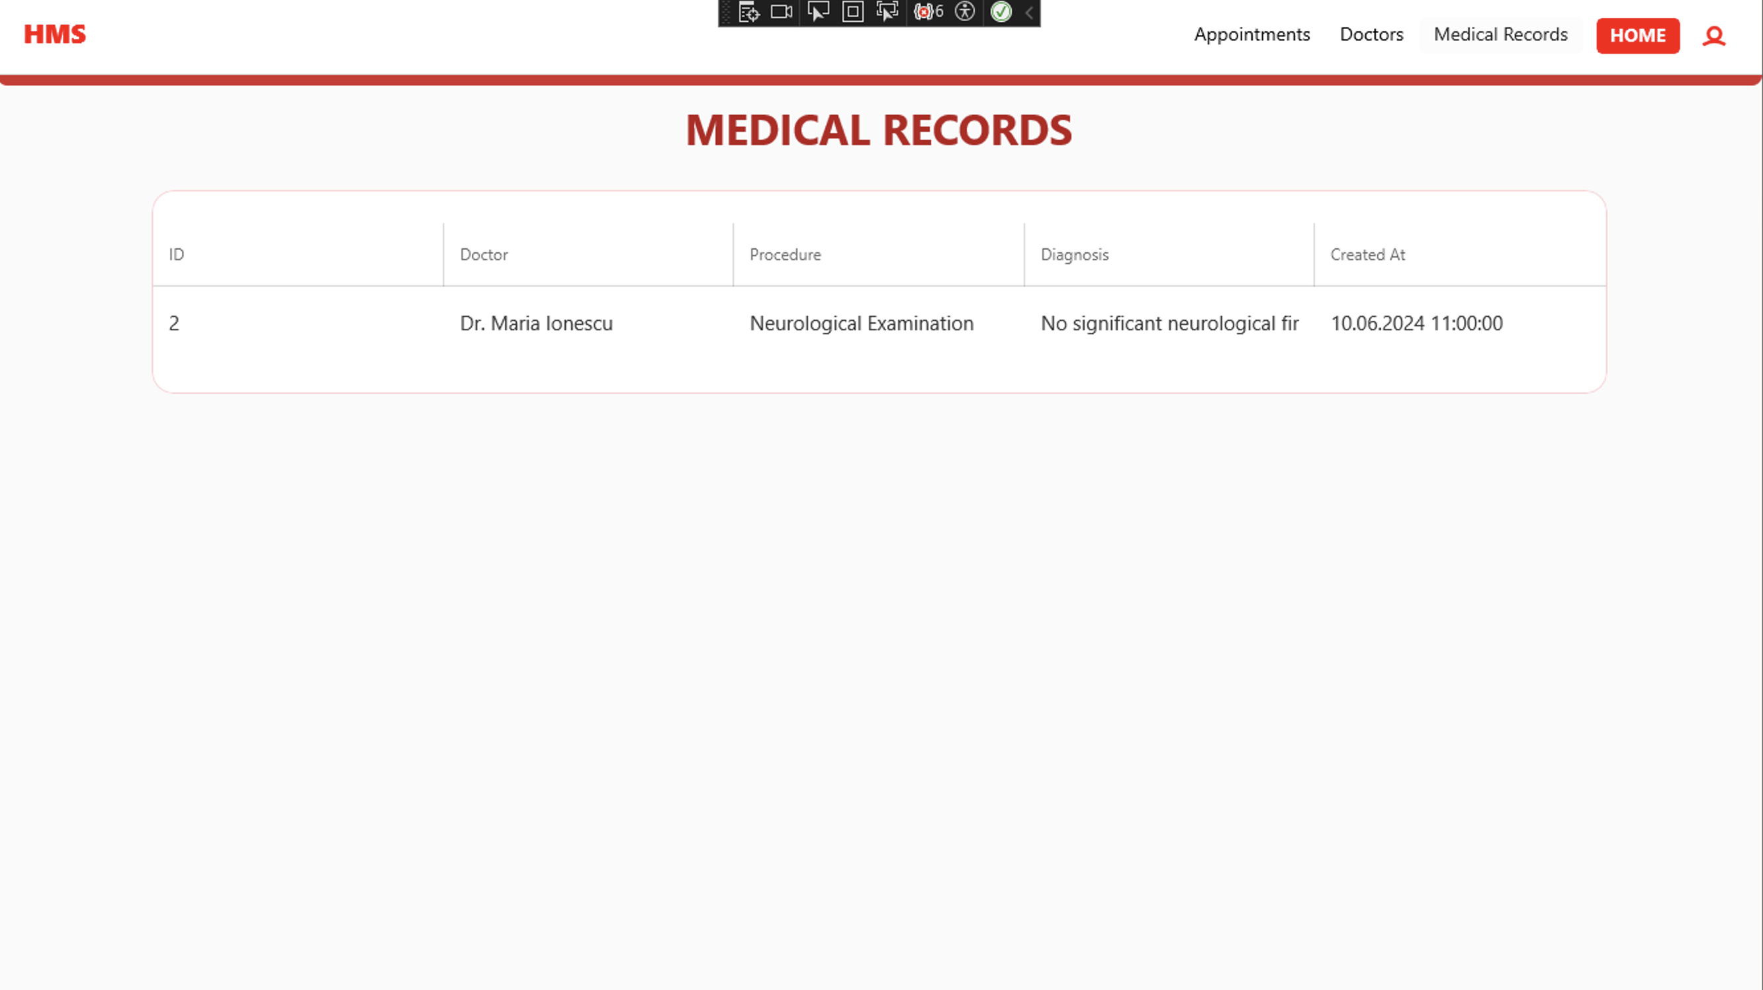
The patient dashboard - Desktop

Slide 29
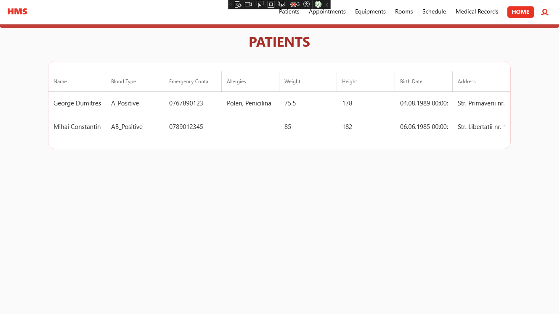
The doctor dashboard - Desktop

Slide 30
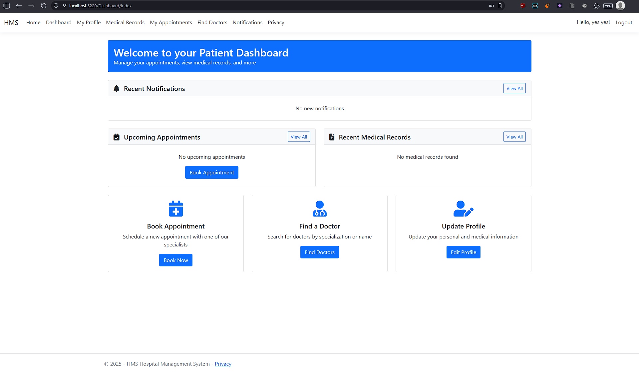
The patient dashboard - Web

Slide 31
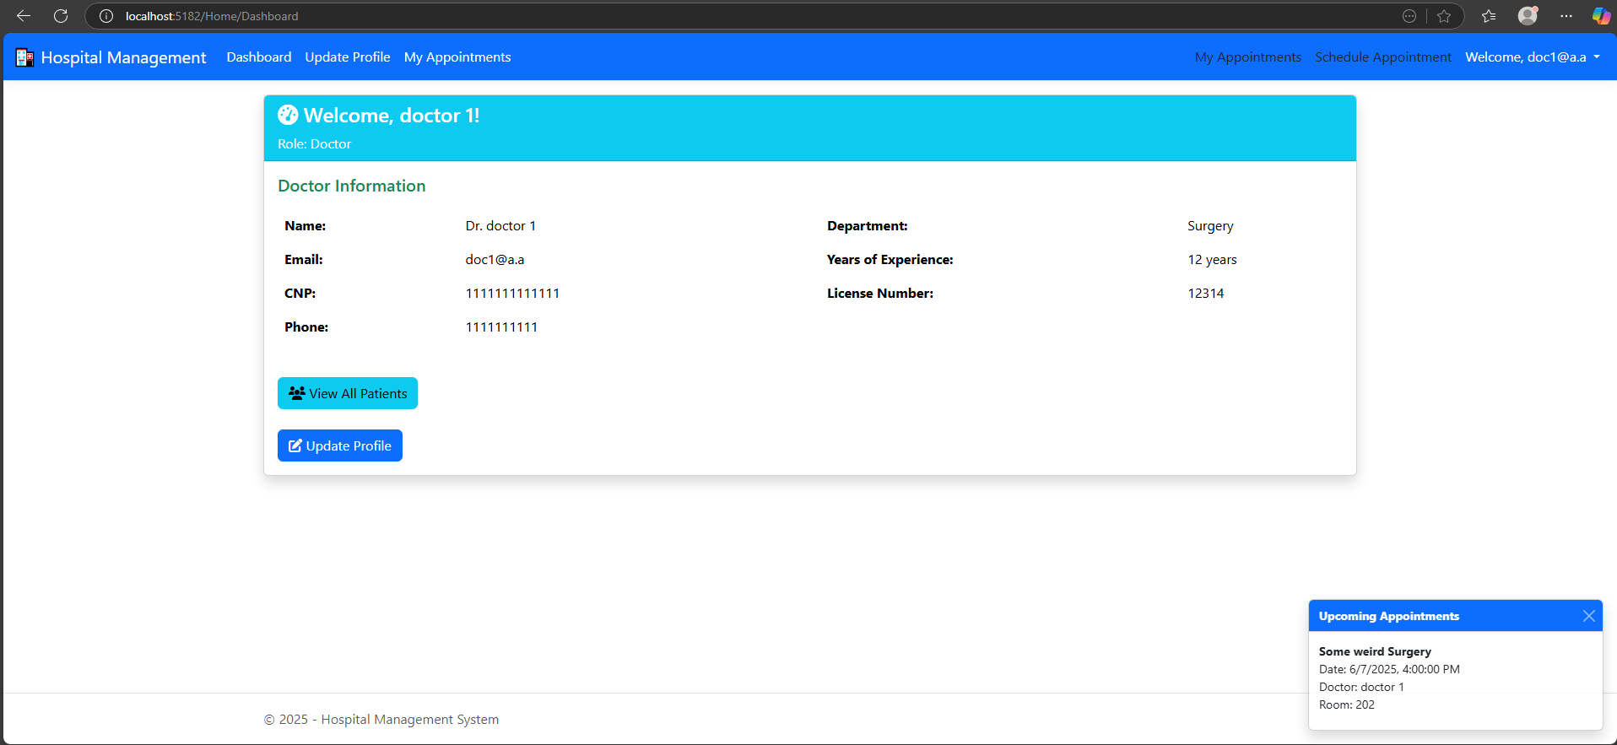
The doctor dashboard - Web

Slide 32
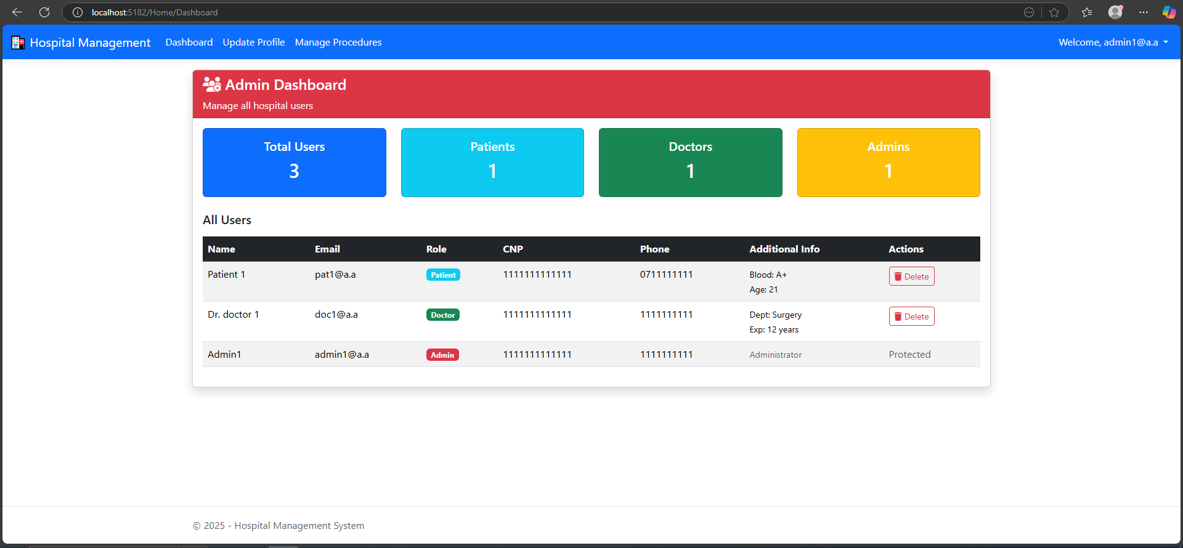
The admin dashboard - Web

Slide 33
Demo time

Slide 34

Thank you!

